Slide 1
SICX OSS Gateway

Slide 2
SICX OSS Gateway
Consumer-oriented view of SICX
Allows consumers to take part in SICX
  Buy and offer resources
  Looser SLAs, RAIC- thinking
  Experimental features
A P2P resource-sharing network
  Shared folders
  But with SICX-like economics

Slide 3
Technical overview
Lookup nodes for peer discovery
Self-signed certificates as identities
  Leap-of-faith and trusted third party introductions
Host Identity Protocol for connectivity
  NAT/Firewall traversal
'Seamless' OS integration
  Client daemon used through file system

Slide 4
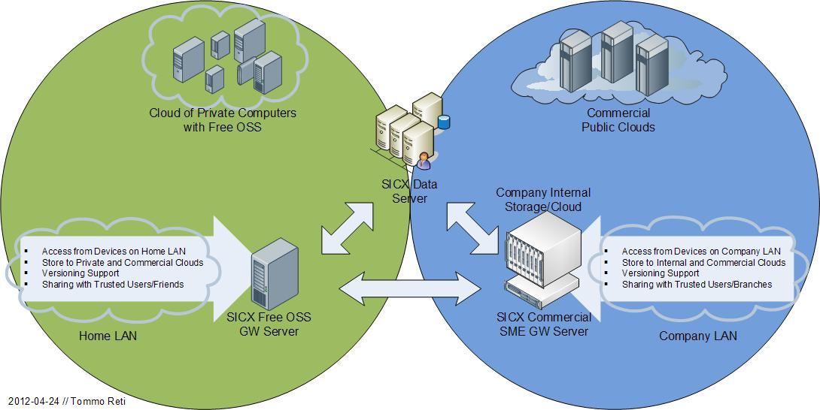

Slide 5
Demo: installation & setup
Start the SICX OSS Gateway
Use SICX credentials or create a new identity
Initialize and browse a shared folder

Slide 6
Demo: inviting users
Share your public identity (make friends)
Import contacts
  Leap-of-faith introduction
Invite them to your folder
Accept the invite, browse the folder

Slide 7
Demo: data syncing
Add new content
  Automatic synchronization
View content
  Pro-active downloads
Continue session P2P
  Killing the lookup node does not affect the sharing

